Slide 1

Understanding Your Client’s Personality
Written by Hope DeVall, LMBT

Slide 2
Course
Objectives
      Discuss an overview of personality theory based on the Jungian influenced Myers-Briggs Personality Indicator.
      Describe the personality polarities and associated “types”
      How personality influences the therapeutic relationship
      Explain components and drivers of different personalities
      Articulate how your personality impacts your own and your clients' experience
      Identify what drives different personalities and how to relate to various types of individuals
      Implement techniques to manage your clients in ways that result in better outcomes

Slide 3


Activity
On a note card the following:
a personality trait that irritates you
a personality trait that you admire in others

Slide 4
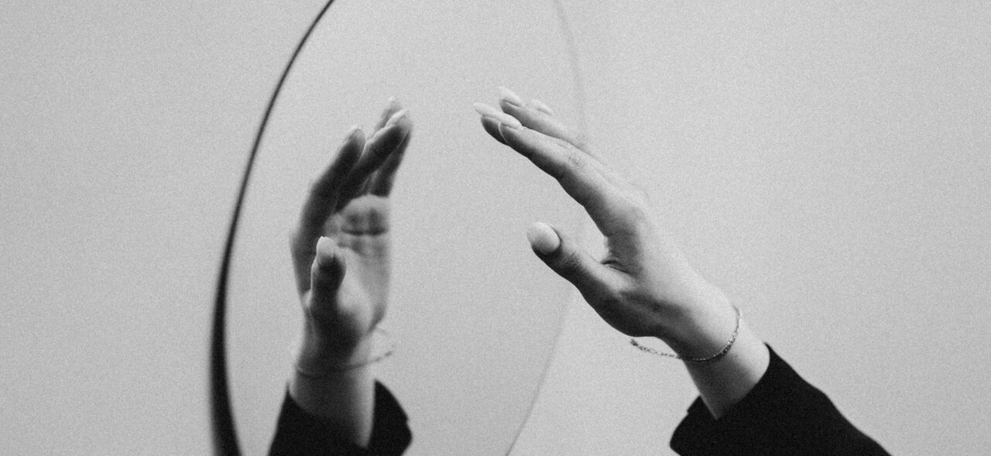
Ask yourself…
Key takeaways
  It is important to understand your own reactions to the personality of others in order to provide the best service.
  Many people admire a trait they do not possess and are irritated by other traits they do not perceive themselves to have.
  Understanding personality type can help build empathy for styles that are dissimilar to your own and can help you understand your own tendencies and preferences.
Are the traits you listed similar to your own personality traits, or different from you?
How many of your clients have the trait you admire?
How many of your clients have the trait that irritates you?

Slide 5
Personality Theory
The theory of psychological types was described most famously by Swiss psychiatrist and psychologist Carl Gustav Jung (1875-1961).
It has become known as Jungian theory.
The essence of Jungian theory is that much seemingly random variation in behavior is actually quite orderly and consistent, being due to basic differences in the ways individuals prefer to use their perception and judgment.

Slide 6
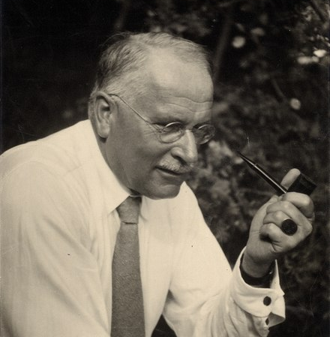
Quotes by Carl Jung
“Everything that irritates us about others can lead us to a better understanding of ourselves”
“The meeting of two personalities is like the contact of two chemical substances; if there is any reaction, both are transformed”
“The shoe that fits one person pinches another; there is no recipe for living that suits all cases”
“Knowing your own darkness is the best method for dealing with the darkness of other people”
This Photo by Unknown Author is licensed under CC BY-SA

Slide 7
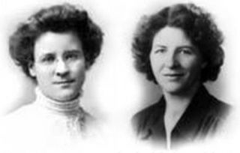
Personality Type Theory
Myers-Briggs Type Indicator
The most famous personality type instrument (test) is the MBTI. MBTI stands for Myers-Briggs Type Indicator.
Many other personality type tools exist ( Enneagram, Big 5, DISC, DESA, Strengthsfinders, etc.) and most personality inventories use some form of Jungian psychology.
Isabel Briggs-Myers, and her mother, Katharine Briggs, had the goal of making the insights of type theory accessible to individuals as well as groups. Therefore, they developed and applied the MBTI instrument, which is one of the best tested and validated on the market.
The mother-daughter team of Myers and Briggs identified basic preferences of each of the dichotomies specified or implicit in Jung’s theory, which we will discuss in detail on the following pages of this course.

Slide 8
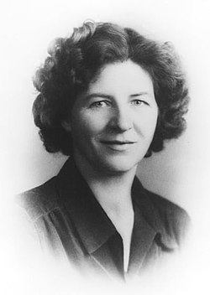
"Perception involves all the ways of becoming aware of things, people, happenings, or ideas. Judgment involves all the ways of coming to conclusions about what has been perceived. If people differ systematically in what they perceive and in how they reach conclusions, then it is only reasonable for them to differ correspondingly in their interests, reactions, values, motivations, and skills."
- Isabell Briggs-Myers
This Photo by Unknown Author is licensed under CC BY-SA

Slide 9

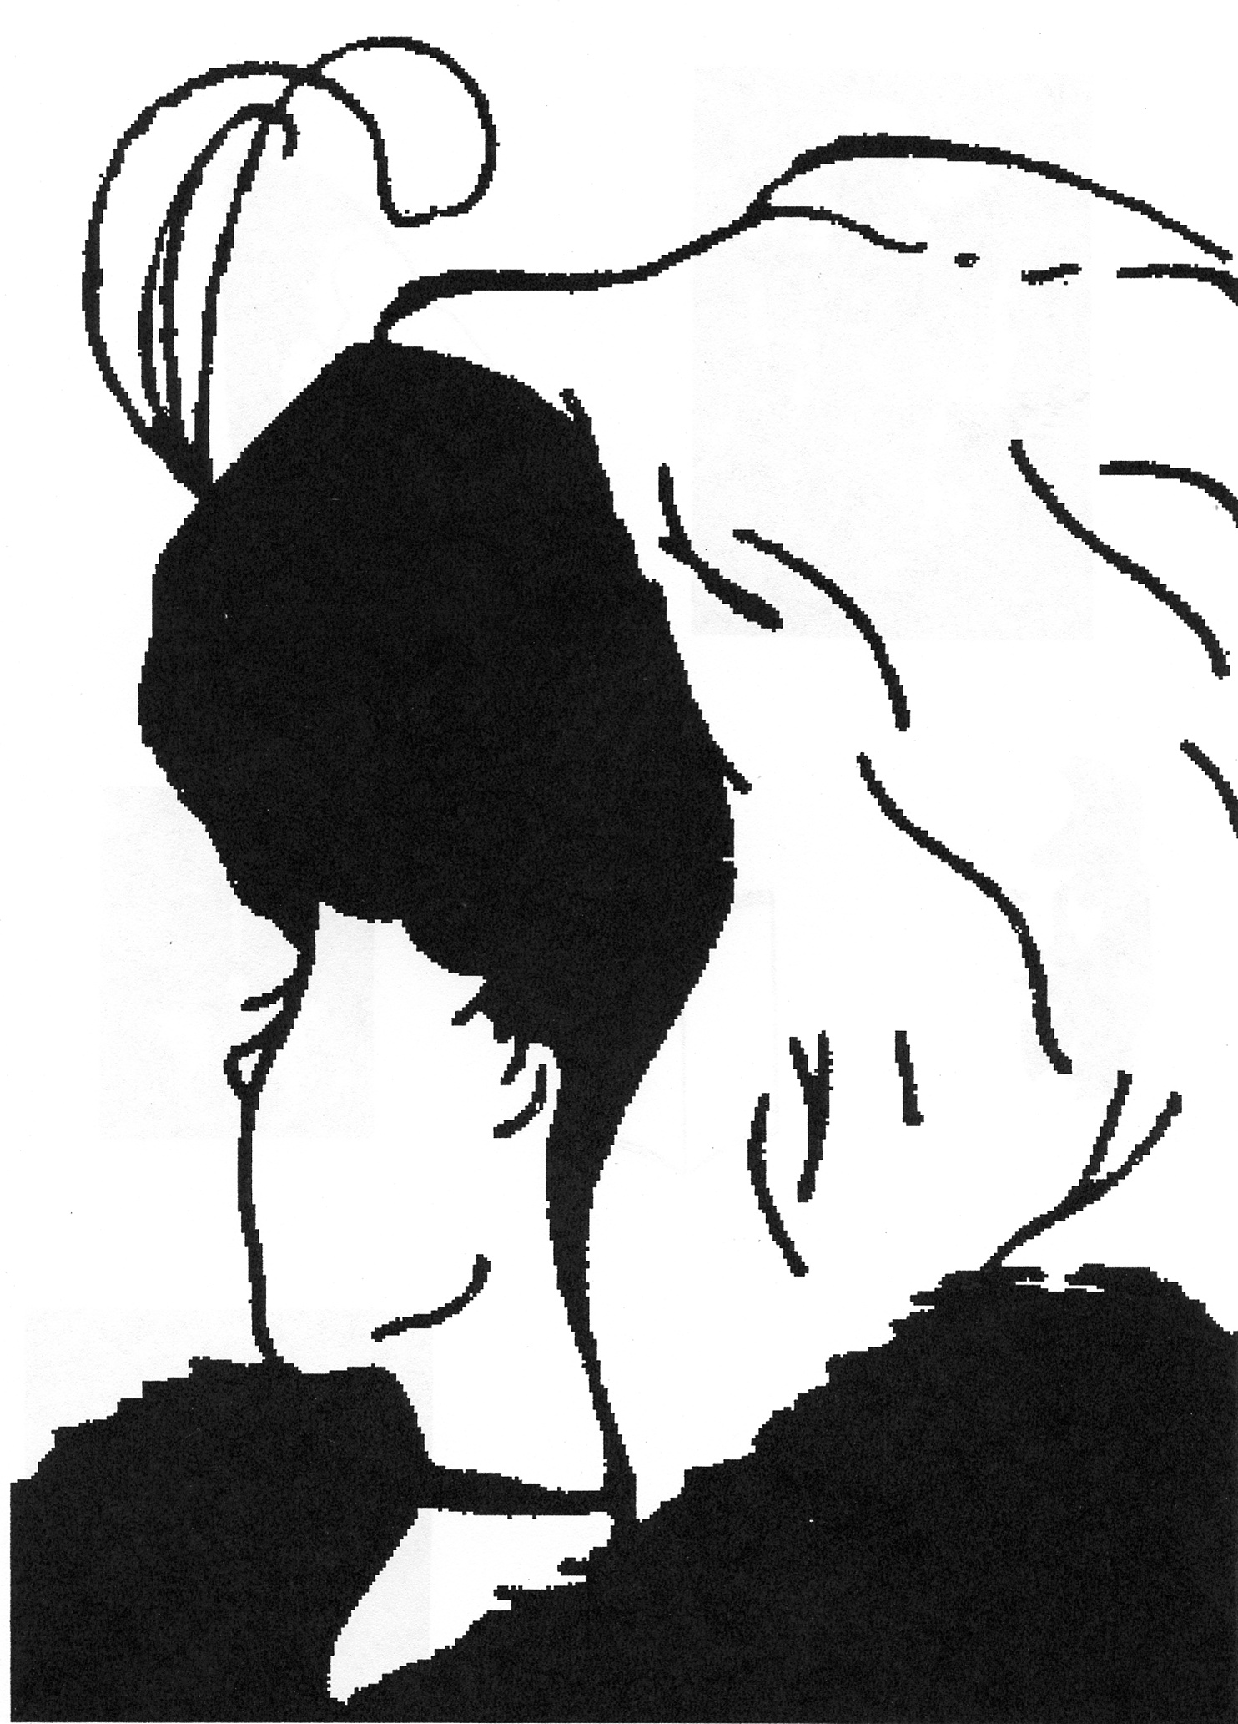
What do you See in this image?
Perception Activity
This Photo by Unknown Author is licensed under CC BY-NC

Slide 10
Perception Activity
Old Woman/ Young Woman
Old Woman
Young Woman
Old Woman. Many people see an old woman with a very large Roman nose and a tiny slip of a mouth; her chin is tucked down in the fur shawl, and she has what appears to be a babushka or hat on her head with dark hair down to her eyes, only one of which is visible and appears to have a bag under it.
If you did NOT see the old woman, go back to the previous page after reading this paragraph to see whether you can now spot her.
Many people, however, see a very young woman. The young woman is in profile, with a feather on her head. If you have a hard time seeing her, note that her chin is the same as the nose of the older woman. She has a choker necklace on, where the old woman’s mouth was. She looks like a young dancer, perhaps.
If you did not see the young woman at first, go back to the previous page with this description to see if you can find her.

Slide 11


Did you see something different?
Occasionally, someone will see something else, in addition to the old or young woman. If you see another picture, the Mind Body Connection would like to hear from you, so we can include it in future sessions.
It is important to note that neither view is “wrong”; instead, this exercise is an example of how very differently people see the exact same thing.
Remembering this example can demonstrate how important it is to test your assumptions and perceptions, and not assume others share the same way of thinking that you do.
This Photo by Unknown Author is licensed under CC BY-NC-ND

Slide 12
Personality Typing Theory
Meyers Briggs Typology

Slide 13


Myers Briggs Typing
Asks participants to identify their preferences
Based on Carl G. Jung's theory of psychological type, people can be characterized by using:
  Two mental functions. Carl Jung called these variation in mental functioning Sensing-iNtuition and Thinking-Feeling
  Attitude. Carl Jung considered attitude to be based on Extraversion-Introversion.
  Isabel Briggs Myers [Myers, 1980] emphasized a fourth parameter that also influences personality type characteristics: Judging-Perceiving
This Photo by Unknown Author is licensed under CC BY-NC

Slide 14

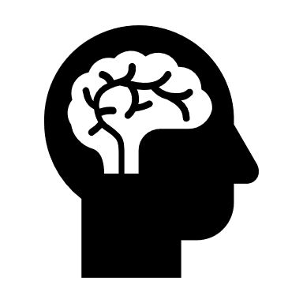


Personality Components
  Extraversion – Introversion (E/I)
  Sensing – iNtuition (S/N)
Personality typology is based upon the following four dichotomies. A dichotomy is a dimension where each pole represents an opposite preference
  Thinking – Feeling (T/F)
  Judging – Perceiving (J/P)

Slide 15
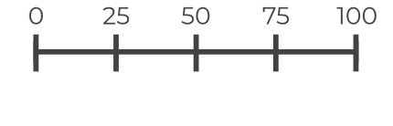
Personality Type Theory
Myers-Briggs Type Indicator
It’s also important to remember that these dichotomies represent PREFERENCES, not absolutes. Just because someone is an introvert does not mean that they cannot act in an extraverted way; however, they learned, likely early in life, to PREFER introversion.
When someone has a very high preference, it means that they use that preference most of the time. This can be a strength or weakness, depending upon how well the individual knows themselves and how open they are to others with a different preference.
One of the key factors about the dichotomies is that they are scalable.
Each dichotomy can span from 0% to 100%; i.e. you may be 10% extraverted or 85% extraverted.
Since you can be high, medium or low in your preference (highly introverted, mildly introverted, highly extraverted, mildly extraverted), we cannot assume that every extravert will act the same way. Remember, we are all individuals with individual personality types.

Slide 16
Personality Components
  For example:
  ISTJ stands for an Introvert, Sensing, Thinking, Judging
  ENFP stands for an Extravert, iNtuitive, Feeling, Perceiving
All possible variations of the 4 dichotomies can be put together to define 16 different personality types. Each type can be assigned a name (personality type formula), as an acronym of the combination of the 4 dimensions that defines the personality type.

Slide 17
The 16 personality types are:
ESTJ ISTJ ENTJ INTJ
ESTP ISTP ENTP INTP
ESFJ ISFJ ENFJ INFJ
ESFP ISFP ENFP INFP

Slide 18
Personality Assessment
Assessment Tool
Self-study
For this class, you took the Jung Typology Profiler for Workplace instrument online (JTPW™).
This instrument determines, among other things, the personality type of an individual. It uses the type letters and dichotomies you have already learned in this course (E/I; S/N; T/F; J/P). However, it goes beyond the 4 Jungian dichotomies and measures several additional factors that make it possible to apply Jungian typology and assess behavioral preferences in the context of a workplace.
The JTPW™ instrument also provides personalized, dynamic descriptions of Jung's personality types, focused on aspects such as preferred activities, decision making, problem solving, creativity, change management, conflict management, and interpersonal style.
We will not break down all these additional components in this course, but you may want to do further study on your own and can find many resources for this type of study online.

Slide 19
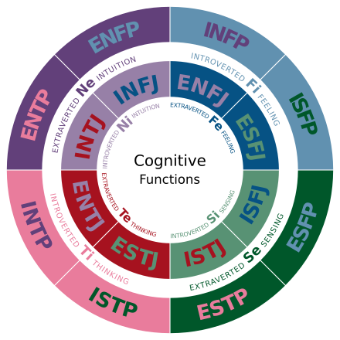
Let’s review your personality profile
Introduce yourself and share your 4-letter Type
This Photo by Unknown Author is licensed under CC BY-SA

Slide 20

What is your “Type”?
This report includes:
  Your Personality Type
  Most favorable work environment
  Personality strengths
  Career development and marketing for you
  Pitfalls
You will receive a copy of your personalized personality assessment report as a part of this course.

Slide 21

Personality Report
Review Your Assessment
Please click the link in your email and spend some time reviewing and “digesting” your personality report
If you cannot understand your report, We are here to help. Ask for assistance and we can walk you through a further explanation.
One of the most common questions after reviewing personality type is: How common or frequent is my type?

Slide 22

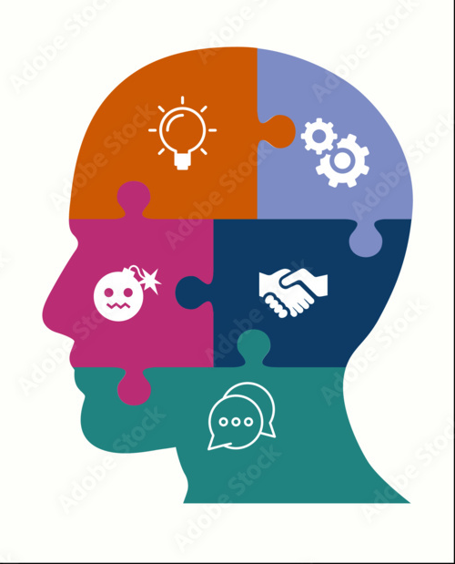
Personality Makeup in U.S.*
Extravert 49.3%
Introvert 50.7%
Sensing 73.3%
iNtuitive 26.7%
Thinking 40.2%
Feeling 59.8%
Judging 54.1%
Perceptive 45.9%

Slide 23
Type Questions
For more information please visit:
http://www.myersbriggs.org/my-mbti-personality-type/my-mbti-results/how-frequent-is-my-type.asp
On the following pages, we will discuss the key questions related to personality typing, and you can learn the patterns that make up your personality.
The most common personality types include ISTJ (ranging from 11-14% of those tested), ISFJ (9-14%), ESTJ (8-12%) and ESFJ (9-13%).
INFJ is the least common type (1-3%), but many other types are approximately 2-5% of those scored (INTJ, INTP, ENTP, ENFJ, ENTJ).
The remaining personality types make up from 4-9% of the population tested.

Slide 24
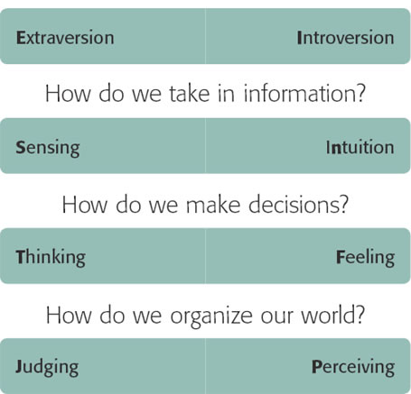
Four MBTI Dichotomies
Where do we get our energy?

Slide 25
Key Questions
Decisions: When making decisions, do you prefer to first look at logic and consistency or first look at the people and special circumstances? This is called Thinking (T) or Feeling (F).
Structure/Organization: In dealing with the outside world, do you prefer to get things decided or do you prefer to stay open to new information and options? This is called Judging (J) or Perceiving (P).
Favorite world/Energy: Do you prefer to focus on the outer world or on your own inner world? This is called Extraversion (E) or Introversion (I).
Information: Do you prefer to focus on the basic information you take in or do you prefer to interpret and add meaning? This is called Sensing (S) or Intuition (N).

Slide 26

People are Complex
Preference (dominant function):
  It is absolutely critical to NOT use personality typing to stereotype individuals; in truth, we all have access to all eight functions at all times; one process will become dominant in most people and the other play a supporting role
    An Extravert will sometimes need to process things internally or have time along (be introverted)
    An iNtuitive will be perfectly capable of managing details using his/her Sensing skills
    A Thinker is very capable of Feeling, a Feeler is perfectly capable of Thinking
    Depending upon the level of the preference, it may be more or less difficult to use non-dominant functions

Slide 27
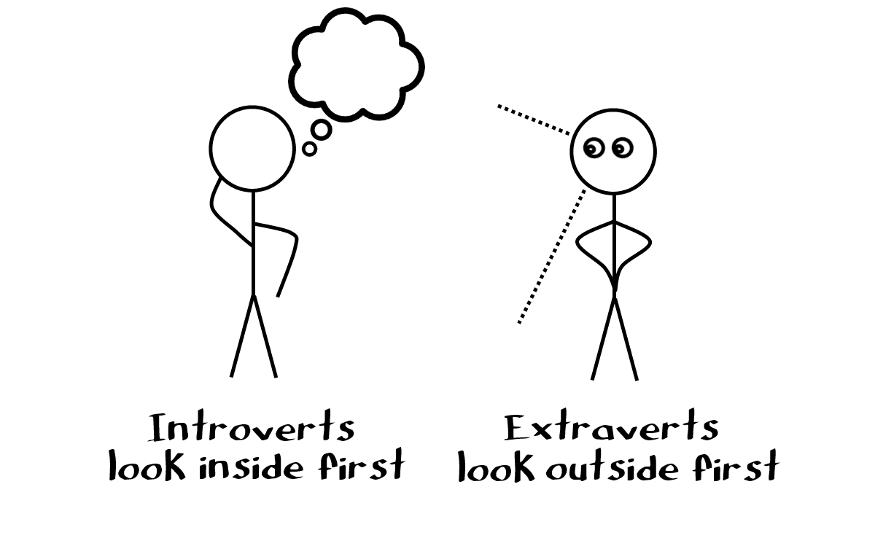
Components of Personality
  Carl Jung introduced the notion about the Extraverted or introverted direction of each of the mental functions we will outline on the next few page (S/N; T/F). Therefore, E/I is connected to these other preferences.
  The direction points to the source of energy that feeds the dominant mental function.
  An Extravert's source of energy is mainly found in the outside world (outside themselves), whereas an Introvert's source of energy is mainly found in his or her inner world (inside themselves).
Extravert/Introvert (E/I): Energy

Slide 28
Extravert/Introvert (E/I): Energy
We are Extroverting when we:
We are Introverting when we:
Talk to other people
Listen to what someone is saying
Cook dinner, or make a cup of coffee
Work on a car
Read a book
Think about what we want to say or do
Are aware of how we feel
Think through a problem so that we understand it

Slide 29
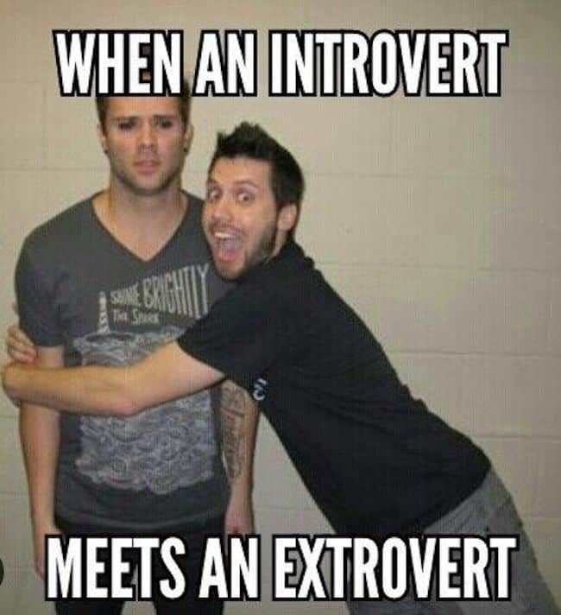
E/I Questions:
  Do you draw energy from being in a group?
  Do you need alone time or solitary time to recover after being in a group?
  Do you like to talk it out or run things by someone else prior to making a decision?

Slide 30
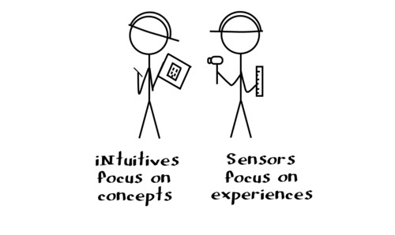
Components of Personality
  The first dichotomy Carl Jung observed was SN (Sensing/N for iNtuition)
  S/N represents the way in which an individual receives information. We all receive through our senses.
  To people who fall into the Sensing category, information they receive through their senses directly is most important (literal, concrete).
  People falling into the Intuition category mostly rely upon their conception about things, based on their perception of the world (ideas, concepts, possibilities, abstracts). They sense indirectly.
Sensing/iNtuition (S/N)

Slide 31
Sensing/iNtuition (S/N)
We are Sensing when we:
We are Intuitive when we:
Taste food
Notice a stoplight has changed
Memorize a speech
Follow steps in a plan, and/or see details of a plan
Come up with a new way of doing things
Think about future implications for a current action
Perceive underlying meaning in what people say or do
See the big picture

Slide 32
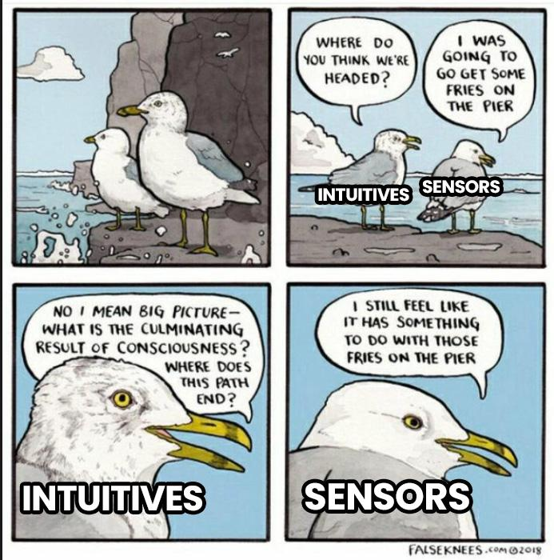
S/N Questions:
Ask yourself: Do you become annoyed if someone around you isn't very good with details? (likely “S” behavior)
Do you get frustrated when someone you are dealing with cannot see the “forest” for the “trees” or can't see the “big picture? (likely “N” behavior).

Slide 33
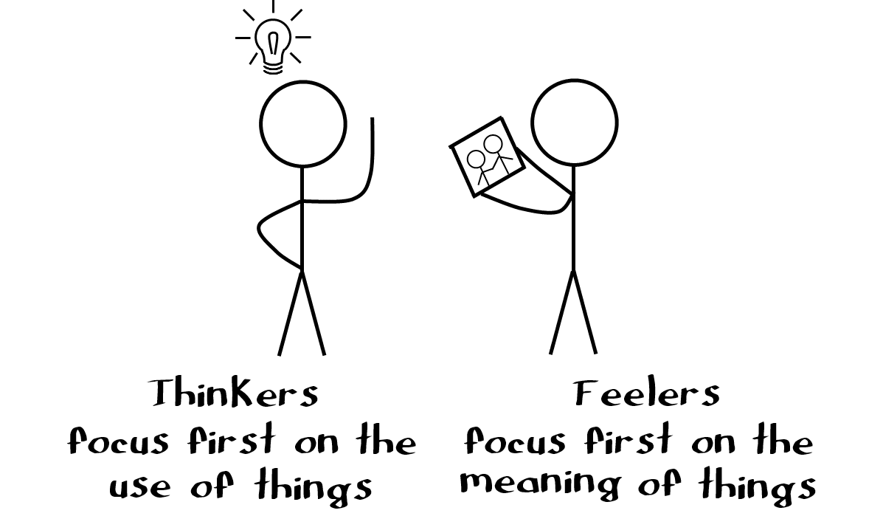
Components of Personality
  The second dichotomy, T/F (T stands for Thinking and F - for Feeling), refers to how an individual processes information.
  Thinking means the individual is less affected by emotions and their base for decisions is unbiased reasoning.
  Feeling means that the individual's base for decisions is mainly feelings and emotions.
  Most decisions involve some thinking and some feeling, and decisions we find most difficult usually involve conflicts between our thinking and feeling sides.
  When someone makes a decision based on Thinking, it means they are relying on logic and reason. They make decisions in a rational, logical manner perceived to be fair based on pre-defined rules of behavior.
  When someone makes a decision based on Feeling, it means they are relying on making decisions on the individual case, in a subjective manner based on their own value systems.
Thinking/Feeling (T/F)

Slide 34
Thinking/Feeling (T/F)
We make decision in Thinking mode when we:
We make decision in Feeling mode when we:
Research a product via consumer reports, and buy the best one to meet our needs
Do "The Right Thing", whether or not we like it
Choose not to buy a blue shirt which we like, because we have two blue shirts
Establish guidelines to follow for performing tasks
Decide to buy something because we like it
Refrain from telling someone something which we feel may upset them
Decide not to take a job because we don't like the work environment
Decide to move somewhere to be close to someone we care about

Slide 35
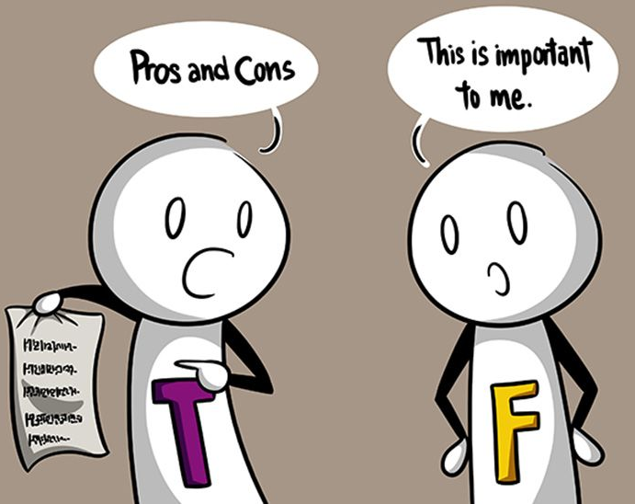
T/F Questions:
“They are so emotional...what a crybaby!” – Likely T statement
“They need to toughen up!” – T statement
“They need to take the emotion out of this decision; are letting their emotions cloud their judgment”. – T statement
“That person is just so cold!” – F statement
“They always wears a poker face.” – F statement

Slide 36
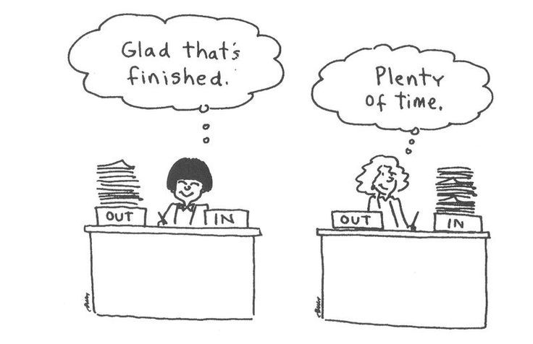
Components of Personality
  The difference between Judging and Perceiving is probably the most marked difference of all the 4 preferences.
  People with strong judging preferences may have a hard time accepting people with strong perceiving preferences, and vice-versa. Judging and perceiving preferences, within the context of personality types, refers to our attitude towards the external world, and how we live our lives on a day to day basis.
  People with the Judging preference want things to be neat, orderly and established.
  People with the Perceiving preference want things to be flexible and spontaneous.
  Judgers want things settled; perceivers want things open-ended.
Judging/Perceiving (J/P)

Slide 37
Judging/ Perceiving (J/P)
We are using Judging when we:
We are using Perceiving when we:
Make a list of things to do
Schedule things in advance
Form and express judgments
Bring closure to an issue so that we can move on
Postpone decisions to see what other options are available
Act spontaneously
Decide what to do as we do it, rather than forming a plan ahead of time
Do things at the last minute

Slide 38
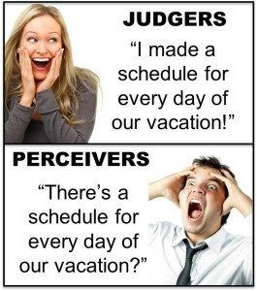
J/P Questions:
Do you feel most comfortable when the course ahead is well-marked?
would you rather come up with five backup plans than deal with events as they come?
Do you prefer to “go with the flow”?
Can you pivot easily when a challenge arises?
Do you know where your phone is right now? (j/k)

Slide 39
Carl Jung also introduced the idea of a hierarchy of mental functions.
Carl Jung called the S/N mental function "irrational" and the T/F "rational“
  The "rational" function, according to Jung, is typical for mental activity that results in thinking, feelings, response and behavior that consciously operates in line with some rules, principles or norms. People with predominantly "rational" function perceive the world as an ordered structure that follows a set of rules.
  The "irrational" function, according to Jung, is typical for mental and perceptual activity that predominantly (and, for the most part, unconsciously) operates with opportunities, i.e. various possible outcomes and sensations result from some premises and sensations, mostly driven by unconscious processes.
As a reminder, the mental functions are S/N and T/F (these are also called the middle factors, since they occur in the middle of the personality type; i.e., ESTJ, ENFP).
According to Jung, in each individual, one of the poles of the two dichotomies predominates over the rest. This pole defines the dominant function. One of the poles of the other dichotomy defines the auxiliary function.

Slide 40

Components of Personality
By observation or asking certain questions it is possible to determine whether the organization of an individual's nervous system results in thinking, feelings, response and behavior that is predominantly "rational" or "irrational". We refer to this as “Cognitive Process”.
In other words, it is possible to determine whether the person is primarily driven by S, N T, or F.
On the next page is a chart of possible cognitive process hierarchies. The capital letter (Se) means that process is dominant. In the case of an Se, the person is driven by Sensing, with Extraversion as their secondary cognitive process.

Slide 41

The 8 Jungian Cognitive Processes (S/N; T/F)
  Se – Extraverted Sensing
  Si – Introverted Sensing
  Ne – Extraverted iNtuiting
  Ni – Introverted iNtuiting
  Te – Extraverted Thinking
  Ti – Introverted Thinking
  Fe – Extraverted Feeling
  Fi – Introverted Feeling

Slide 42
Cognitive Processes
Important:
  Personality type is the WHOLE PATTERN, not just 4 individual letters. The cognitive processes dominate, but the entire type makes up the whole personality type.
Jung described these eight cognitive processes types as core to driving the personality.
He also suggested that these processes operate not just as the dominant process in a personality but also in other ways.

Slide 43

Type Dynamics
The Roles of the Processes:
  In each of the sixteen types, each of the eight processes plays a different "role" in the personality.
  The type code lets you know what role each process plays for each type. This is called "type dynamics."
Each of the 16 "Types" represents a unique predictable pattern of how the eight cognitive processes (functions) are used in everyday life.

Slide 44

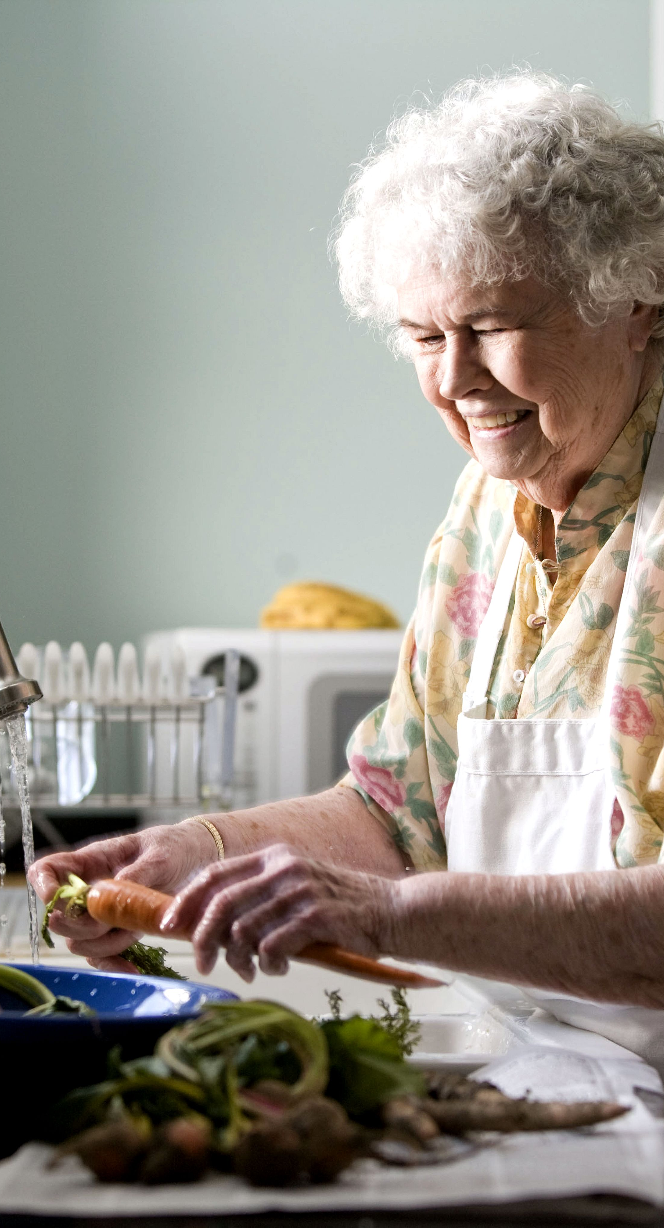
When Do I Develop My Personality?
Each process tends to emerge and develop at different times in our lives.
During these times we are drawn to activities that use these processes. Then, learning the content and the skills that engage these processes is often nearly effortless.
We find our interest is drawn to them and our interest is pulled away from things we were drawn to before.

Slide 45
When do I Develop my Personality?
Being the most trusted and most used, it usually has an adult, mature quality to it. While we are likely to engage in it rather automatically and effortlessly, we have much more conscious control over it.
The energy cost for using it is very low. Much like in the movies, the leading role has a heroic quality as using it can get us out of difficult situations.
However, we can sometimes "turn up the volume" on this process and become overbearing and domineering. Then it takes on a negative dominating quality.
The process that plays the leading role is the one that usually develops early in childhood. We tend to engage in this process first, trusting it to solve our problems and help us be successful.

Slide 46
Personality Roles
There are many roles that develop throughout our lives.
  When we are younger, we might not engage in the process that plays the relief role very much unless our life circumstances require it or make it hard to use the supporting role process. Usually, in young adulthood we are attracted to activities that draw upon this process.
  The relief role often is how we express our creativity. It is how we are playful and childlike. In its most negative expression, this is how we become childish.
  Aspirational or shadow roles may also develop in midlife or later in life, as well as patterns clearer to a developed self. The way these roles develop has a pattern depending upon your personality type.
To learn more about different roles and how they relate to your specific personality type, visit www.cognitiveprocesses.com

Slide 47
Revisiting Types – What is Yours?
ISTJ | ISFJ | INFJ |
INTJ | ISTP | ISFP |
INFP| INTP| ESTP|
ESTP| ESTP| ESFP|
ENFP| ENTP|ESTJ|
ESFJ | ENFJ | ENTJ|
Your Personality Type: Review your own personality type, which can be expressed as a code with four letters.

Slide 48

How Does Personality Type Impact Your Work With Your Clients?

Slide 49
The Client Experience
Many factors affect how your clients’ experience you and your business. Your personality affects how your clients experience you and your business.

Slide 50

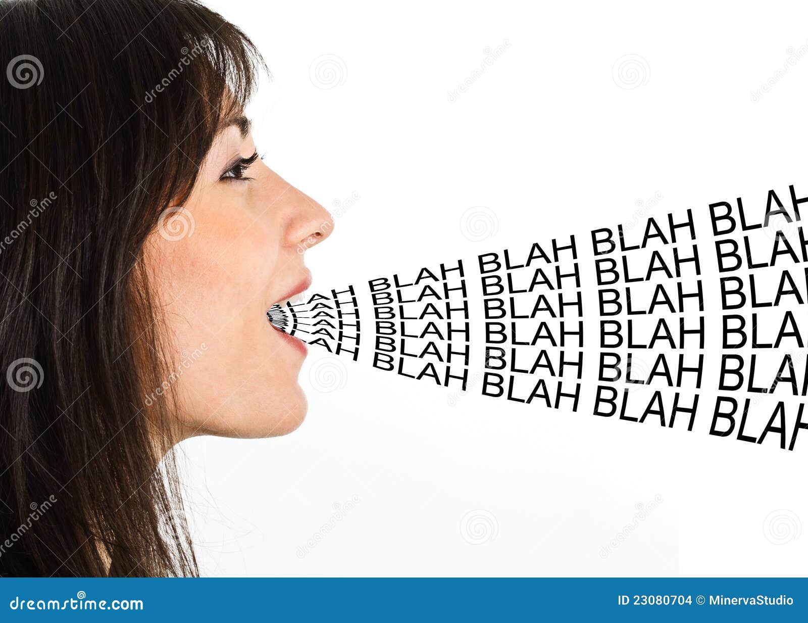
How do you create the right atmosphere for different personalities in your massage practice?
  I/E
  S/N
  T/F
  J/P

Slide 51
The Client Experience
  I/E: Introverts may not want to chit chat much when entering your practice; Extraverts may want to connect more.
  S/N: Sensers may be very interested in details (cost, time, value for the money); iNtuitive types may have creative inspiration or ideas and concepts appear to them during a massage that they can use later.
  T/F: Thinkers tend to be “in their head” and may need to be encouraged to calm their mind; feeling personalities may experience emotion during a massage and may need time after a massage to process emotion.
  J/P: Judging types will typically be on time always (even early!) and will expect a therapist to be there and available for them; perceiving types will be less likely to be concerned with time and may rearrange appointments or be late.
How do you create the right atmosphere for all personalities in your massage practice? Below are a few examples. Please consider your clients accordingly.

Slide 52

R – E – S – P – E – C - T:
Find Out What it Means To Me
Consider 3 of your regular clients, and their unique personalities.
List something you believe each of them will need from you in order to feel respected on the next page.

Slide 53
Respect Activity
R – E – S – P – E – C - T:
1.______________________________________
2.______________________________________
3.______________________________________
Notes:
53
53

Slide 54
Common Sources of Client Conflict Related to Personality
  E/I: Talking too much, not enough; needing time to process or making decisions too quickly
  S/N: Being/not being detail oriented; wanting to see the big picture first, versus needing details prior to seeing the big picture (forest v. trees)
  T/F: Being too “soft” v. too “cold”; using too much/not enough emotion in decision-making
  J/P: Being on time/late; needing to plan ahead.
Examples of common misunderstandings (mis-communication, trust issues)

Slide 55
Opposite Types
For this exercise, you will use your own personality and then look at your opposite personality type (for example, if I am an ENTJ, my opposite type is an ISFP).
1. Answer the questions on the next two pages from your perspective.
2. Then, review the questions from your opposite type's perspective. Notice the difference.
Activity

Slide 56
Me and My Opposite
Questions:
1. What is important to you when you visit your massage therapist's office?
____________________________________________________________________________________________________________________________________________________________________________________________________________________________________
© Mind Body Connection
56
Notes:
56
56

Slide 57
Me And My Opposite
Questions:
2. What behavior do you need from your massage therapist before, during and after a session?
______________________________________________________________________________________________________________________________________________________________________________________________
© Mind Body Connection
57
Notes:
57
57

Slide 58
How Can you Tell Type?
Extraverts v. Introverts
  Louder, demonstrative v. soft-spoken, quiet.
Sensing v. iNtuitive
  Need to see details add up to the end result v. need to see/hear big picture first.
Thinking v. Feeling
  Need to focus on facts or logic v. on caring.
Judging v. Perceiving
  Late v. on-time; last minute Extravert.

Slide 59
Client Experience
Respect for Differences
  It is important as a service provider that we value and honor different personalities, cultures, generations, geographical region, etc. People instinctively know if you value their uniqueness
Deep Understanding of Yourself
  You must know your own hot buttons, red flags, frustrations. You must also be aware of your own strengths, weaknesses, preferences
  By knowing yourself, you can easily determine when something is “your stuff” versus a client or boundary issue.
Willingness to “flex” your Style
  Know when to “Step it up” or “dial it down” – when dealing with E/I
  Be able to articulate the big picture or details – when dealing with S/N
  Toughen or soften your natural style – to deal with T/F
  Provide structure or go with the flow – to deal with J/P
Skills

Slide 60

Communication
Please see handout that was emailed to you with this presentation for more information about the most effective communication strategies with various personalities

Slide 61




Common Massage Therapist Types
This Photo by Unknown Author is licensed under CC BY-SA-NC
This Photo by Unknown Author is licensed under CC BY-SA-NC

Slide 62

This Concludes the Course Material for Understanding your Client’s Personality

